Slide 1
HDMI design review
Huibo Zhong 2017 11.20

Slide 2
Profile
1. video timing introduction
2. hdmi design in Sirius

Slide 3
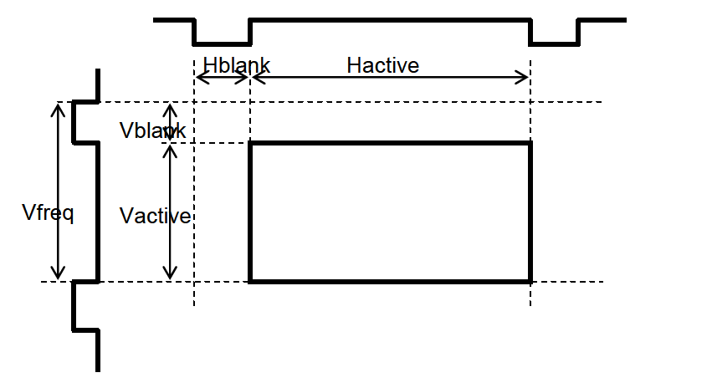
1.VIDEO TIMING
Hblank, Hactive
Vblank, Vactive
FPS
Pixel clock = (Hblank+Hactive)*
(vblank+Vactive) * FPS

Slide 4
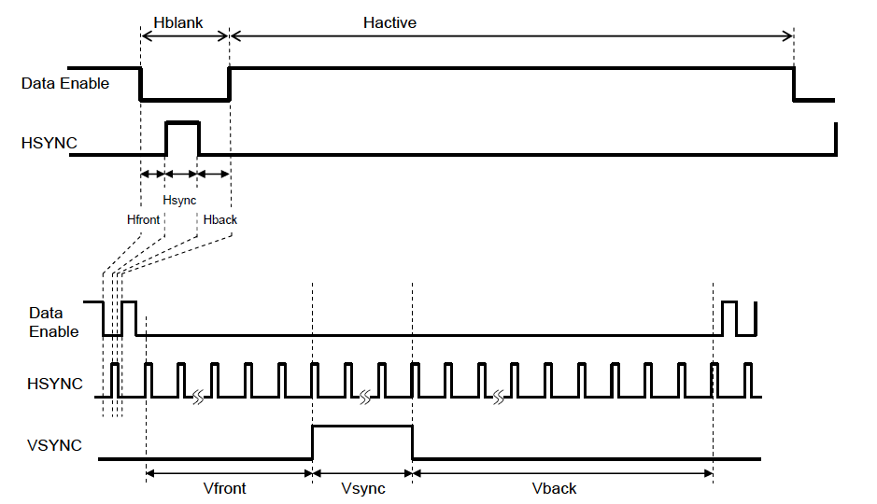
1. VIDEO TIMING
Hblank:
Hfront, Hsync(HSW),
Hback
Vblank:
Vfront, Vsync(VSW)
Vback

Slide 5
1. Video timing
Polarity
Interlace
RGB, YUV
Color depth

Slide 6
2. Hdmi design in sirius
Feature:
1. HDMI1.4, video up to 4k@30fps, RGB/YUV, deep color support
2. HDCP1.4
3. AUDIO. Up to 192kbps, serial and parallel interface in sirius
4. edid mem inside option

Slide 7
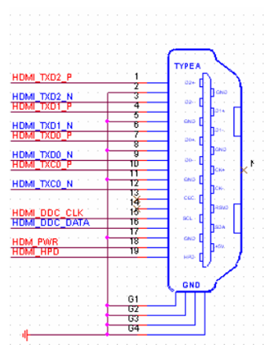
Edid mem inside option
19 pin type A connector
5V system power
HPD

Slide 8
hdmi rx controller diagram

Slide 9
PHY diagram.

Slide 10
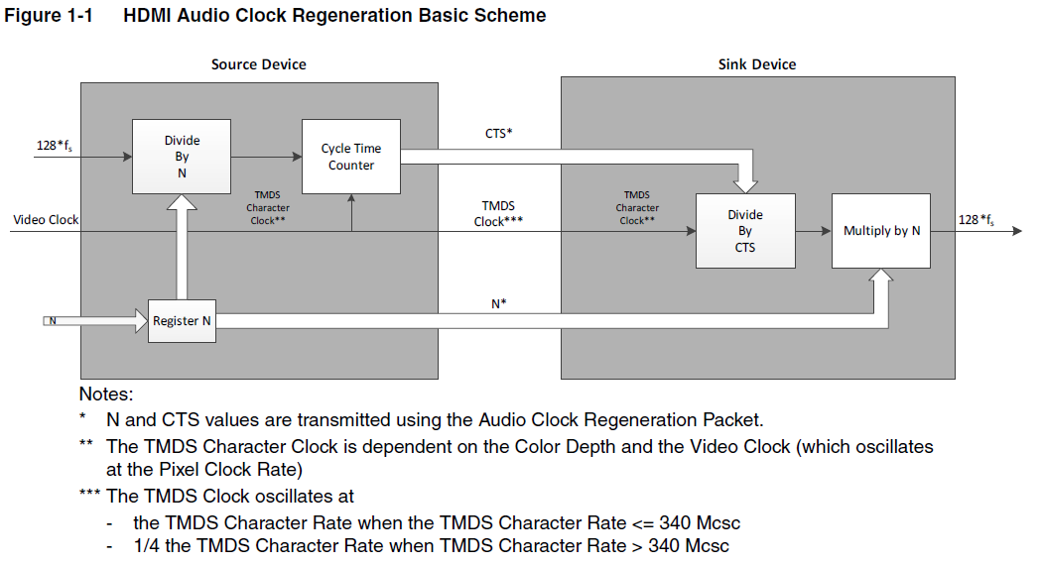

audio pll Interface
ocfg_audpll_mux_cts : 20bit input icfgclk
ocfg_audpll_mux_n : 20bit input icfgclk
O_ctsn_valid : toggle when cts/n change
REQUESTCLK to replace tmdsclk
4.096Mhz ~ 24.576M , 1000PPM

Slide 11
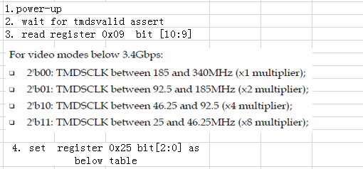
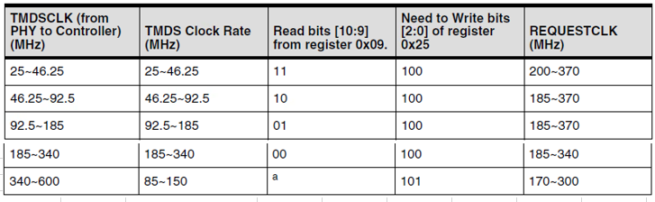
audio pll Interface

Slide 12
Audio interface: parallel
L-PCM and compressed audio
One Bit Audio – DSD
Compressed One Bit Audio –DST
HBR Compressed Audio

Slide 13
Audio interface, serial
Data repeater between HDMI and DPTX
Data repeater between HDMI and i2s

Slide 14
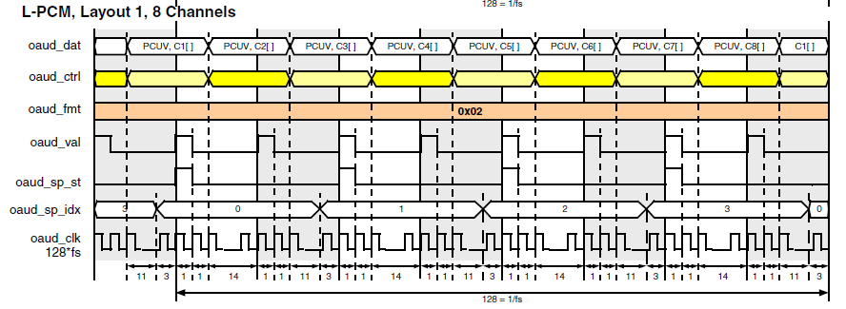
Audio interface:parallel

Slide 15
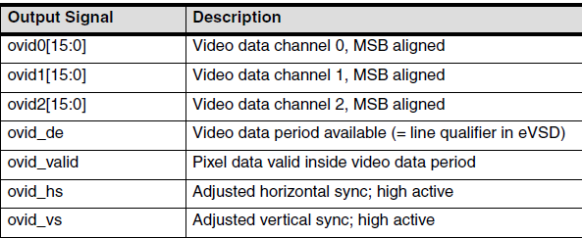
Video interface
To video interface hdmi’s data path

Slide 16
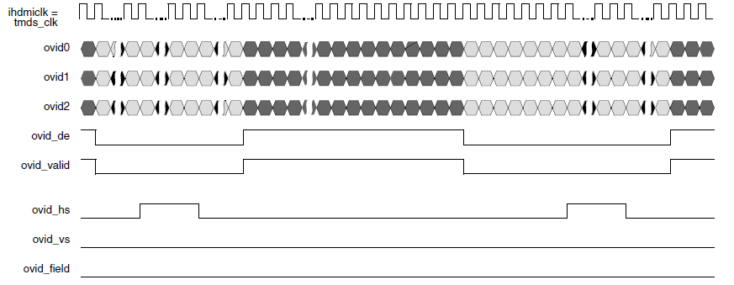
Video interface

Slide 17
Syn and sim
Area:
Phy+controller : 1.23
Local sim env
Soc sim env
 |  | area
RXPHY |  | 0.859
I/O |  | 0.259
total |  | 1.118

Slide 18
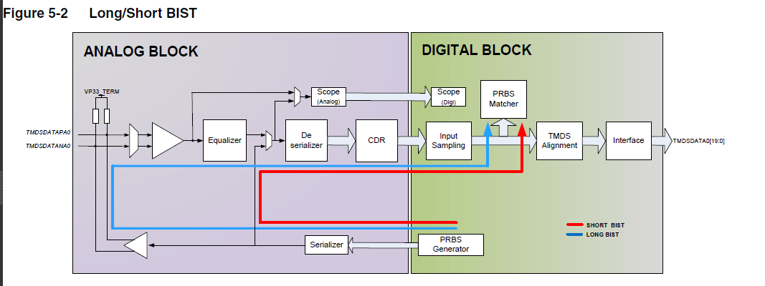
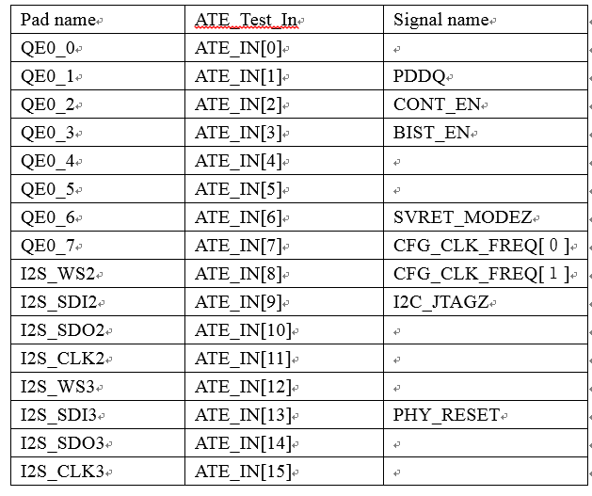
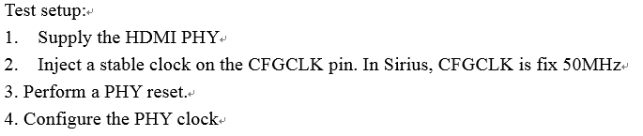
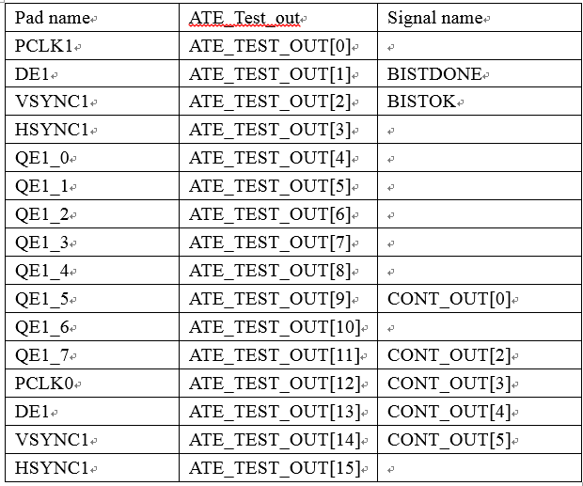
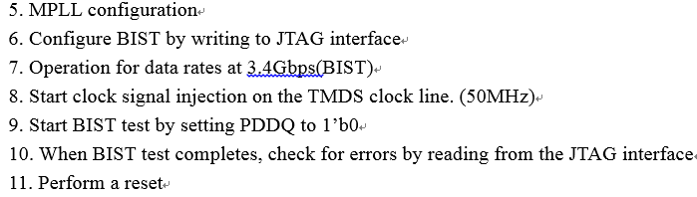
ATE test
Internal long bist

Slide 19
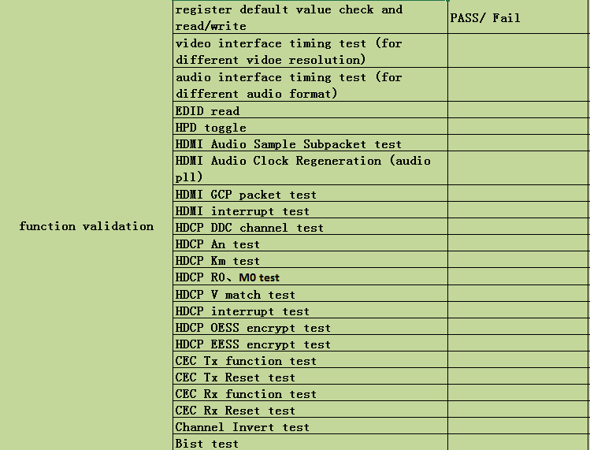
Bring up plan

Slide 20
Thank you

